Slide 1
Image Transformation
Image transformation in digital image processing involves mathematical operations to alter an image, either by changing pixel values (intensity/gray-level transformations like contrast adjustment) or by remapping pixel locations (geometric transformations like scaling, rotating, or shearing) for tasks like alignment, enhancement, or analysis.
Geometric Transformations
Purpose: Alter the spatial arrangement (shape, size, orientation) of pixels.
Examples:
  Translation: Shifting the image.
  Scaling: Resizing (zooming in/out).
  Rotation: Turning the image.
  Reflection: Flipping the image.
  Shearing: Slanting the image.

Slide 2
Scaling in 2D
  Image scaling in processing is resizing an image larger (upscaling) or smaller (downscaling) by creating new pixel data, a crucial operation for applications like web design, computer vision, and gaming.
Translation in 2D
  Repositioning the object along a straight line path from one coordinate location to another. It simply moves the image without changing it’s shape or size.
  Translation vector defines how much to shift an image or its components (pixels) horizontally and vertically, acting as a "slide" that moves points from (x,y) to (x+a,y+b), where ⟨a,b⟩is the vector.

Slide 3
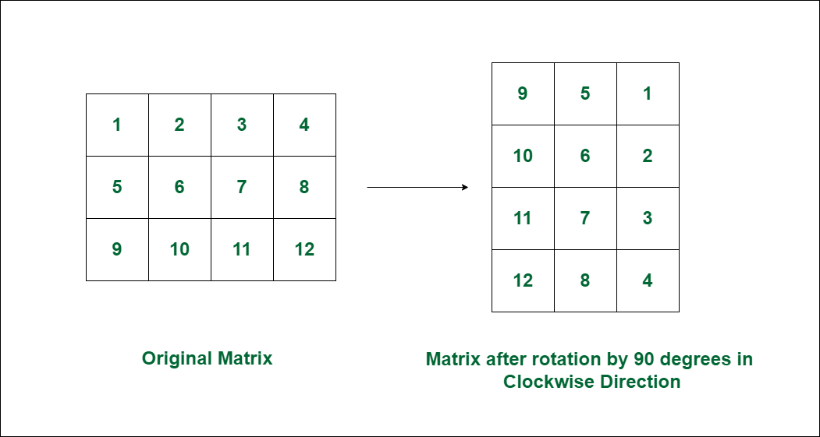
Rotation in 2D
  Image rotation in image processing is transforming an image by turning it around a fixed point (usually the center) by a specific angle.

